Slide 1

Introduction to Erlang Programming
Erlang Characteristics
Virtual Machine
Syntax
Functional vs OOP approach
Messaging
OTP (application, gen_server, supervisors ...)

Slide 2
Erlang Characteristics
1986, open sourced in 1998
Declarative
Concurrent
Distributed
Fault Tolerant
Soft real-time
Open Telecom Platform (OTP)
Efficient Virtual Machine
Dynamic / Strong typing
Garbage Collected
99s of uptime?
… a style of building the structure and elements of computer programs, that expresses the logic of a computation without describing its control flow.
http://en.wikipedia.org/wiki/Declarative_programming
1> A = 10.
10
2> A div 2.
5
3> A div 2.0.
** exception error: an error occurred when evaluating an arithmetic expression
in operator div/2
called as 10 div 2.0
Notes:
Declarative/functional: no shared state, no mutation, recursion, no global namespace
Concurrent: "multiple processes executing during the same period of time". Might not be in parallel
Parallel: execution literally occurs at the same instant, for example on separate processors of a multi-processor machine
Soft: the usefulness of a result degrades after its deadline, thereby degrading the system's quality of service.

Slide 3
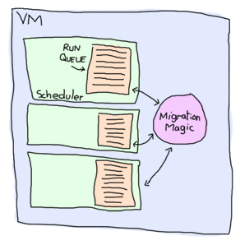
BEAM: Björn's Erlang Abstract Machine
1> Fun = fun() -> receive after infinity -> ok end end.
#Fun<...>
2> {_,Bytes} = process_info(spawn(Fun), memory).
{memory,1232}
Lightweight processes
  Millions!
  1232 bytes of memory
Garbage Collection per process
Message passing
Multi-core
Scheduling
  2k reductions
  yield/bump_reductions..
  Fast context switching
Hitchhiker's guide to the Erlang VM
learnyousomeerlang.com

Slide 4
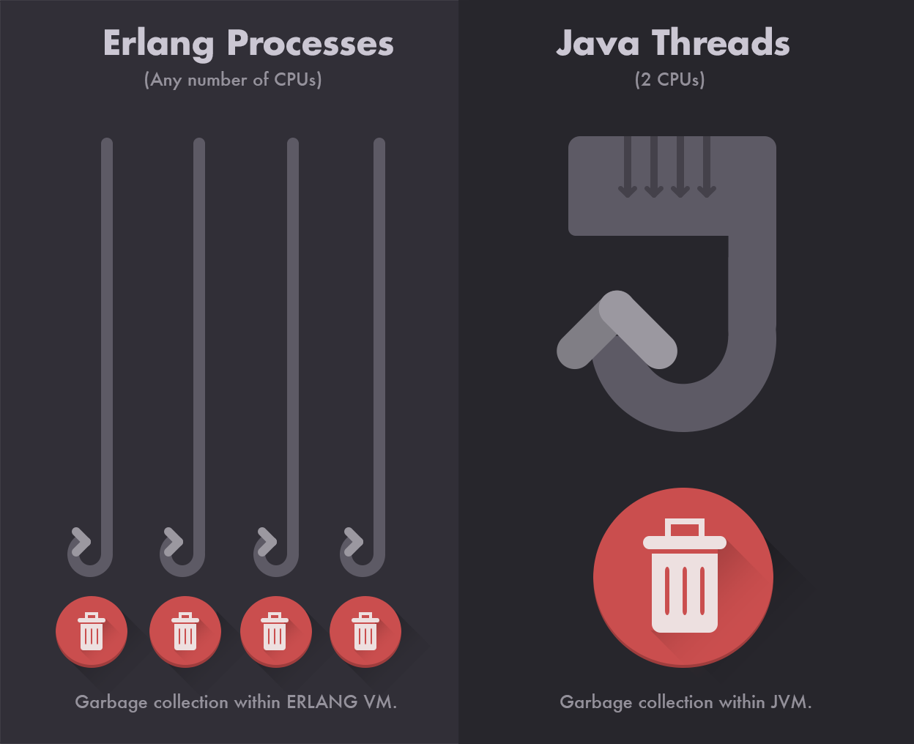
Garbage Collection

Slide 5
Erlang Shell
Interactive environment
Everything ends with a full stop.
c(moduleName). to compile your code
VM inspection i.e. observer:start(), regs(), i(), …
help(). for a list of commands
Ctrl-c and Ctrl-d to break a loop
$ erl
Erlang/OTP 17 [erts-6.3] [source] [64-bit] [smp:4:4] [async-threads:10] [hipe] [kernel-poll:false]
Eshell V6.3 (abort with ^G)
1>

Slide 6
Erlang Basics
1> One.
* 1: variable 'One' is unbound
2> One = 1.
1
3> Un = Uno = One = 1.
1
4> Two = One + One.
2
5> Two = 2.
2
6> Two = Two + 1.
** exception error: no match of right hand side value 3
7> two = 2.
** exception error: no match of right hand side value 2
Variables
  No global scope
  No mutation
  Uppercase
Functions
  module:fun()
  Private/Public
  Pass by reference
  Eager evaluation
  Anonymous
Pattern Matching
  Assignment
  Functions
Notes:
Rest assured that for function calls, each argument is passed as a
single word only: either a pointer, or an "immediate" value (e.g.,
atoms, and integers smaller than about 28 bits - or about 60 bits
on a 64-bit machine). Erlang doesn't even have a built-in "clone"
function, since there is no need for it: there are no destructive
update operations.
- Richard Carlsson
Yes, basically, everything, both arguments and return values, is passed "by reference". But, as you say, this is not noticeable as you can't change a value.
- Robert Virding

Slide 7
Data types
Atoms
Binaries/Bitstrings
Booleans (as atoms)
Funs
Lists (and strings)
Numbers
Tuples
Unique identifiers (pids, ports, references)

Slide 8

Data types: Atoms
Constant literals that stand for themselves (similar to enums)
My_var is a variable my_var is an atom
4 - 8 bytes/atom
Not garbage collected so don't dynamically create them
Some are reserved words
1> atom.
atom
2> atoms_rule.
atoms_rule
3> atoms_rule@erlang.
atoms_rule@erlang
4> 'Atoms can be cheated!'.
'Atoms can be cheated!'
5> atom = 'atom'.
atom
learnyousomeerlang.com

Slide 9
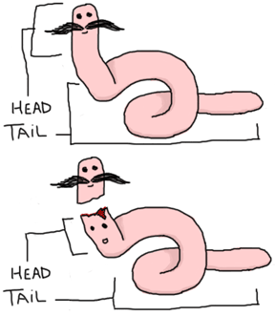
Data types: Lists
Eshell V6.3 (abort with ^G)
1> [Head|Tail] = [1, 2, 3].
[1,2,3]
2> Head.
1
3> Tail.
[2,3]
4>
….....
5> [1 | []].
[1]
6> [2 | [1 | []]].
[2,1]
7> [3 | [2 | [1 | []] ] ].
[3,2,1]
* note proper lists aren't required
Most used data structure
Store any erlang data
Very efficient (BIFs)
[Head|Tail] = [1, 2, 3].
Pipe is the cons operator
true = [a,b,c] < [a,b,x,d]
Not like in Scheme
(cons 1 (cons 2 '()))
> (1 2)
vs.
(cons 1 2)
> (1 . 2)
learnyousomeerlang.com

Slide 10
Data types: Strings
Eshell V6.3 (abort with ^G)
1> "Hello".
"Hello"
2> A = "Hello".
"Hello"
3> [H|T] = "Hello".
"Hello"
4> H.
72
5> [$H, $e, $l, $l, $o].
"Hello"
6> [$H, $e, $l, $l, $o] = "Hello".
"Hello"
7> "abcd" = [97,98,99,100].
"abcd"
8> "Hel" ++ "lo".
“Hello”
Strings are lists of ASCII values
$A, $B, $\n ... to access ASCII values
“Hello”.
String Concatenation:
realloc, and a memcpy O(N) time
VS.
non-contiguous chunks of memory O(1) time

Slide 11
Data types: Tuples
Ordered finite sets
Store any erlang data
{Element1, Element2, ..., ElementN}
Tagged tuples: {tag, value}
{A, B} = {1, 2}.
  > A = 1
  > B = 2
1> element(2, {one, two}).
two
2> tuple_size({one, two}).
2

Slide 12
Data types: Binary/Bitstring
integer | float | binary | bytes | bitstring | bits | utf8 | utf16 | utf32
signed | unsigned
big | little | native
1> <<Var/integer-signed-little>> = <<97>>.
<<”a”>>
<< 0, 1, 2 … 255 >>.
<<”hello”, 32, “there”>>.
Value:Size/TypeSpecifierList
Size is in bytes
Bitstrings can be any length
%% Parse a buffer
parse_buffer(BufferAll, Bytes) ->
case BufferAll of
<<Data:Bytes/binary, Buffer/binary>> -> {Data, Buffer, Bytes};
<<Data/binary>> -> {Data, <<>>, erlang:size(Data)}
end.

Slide 13
Pattern Matching
A = 1.
A = 2.
  ** exception error: no match of right hand side value 2
{A, B, C} = {1, 2, 3}
This call: function({1, 2, 3})
  Will match: function({A, B, C}) → … do something with A
Same principle with lists [] and binaries <<>>

Slide 14
Functions
Are first class data: F = fun() -> 0 end.
Live inside modules
Have Arity: sum/1
Are a collection of clauses separated by a semicolon (;) and terminated by a full stop (.)
Guards
Consider the Base Case
Side effects
Referential Transparency
%% Sum all the ints from 1 to N
sum(0) -> 0;
sum(N) when N > 0 →
N + sum(N - 1).

Slide 15
Guards
Protect function calls
Influence clause selection
%% Sum all the numbers from A to B
sum_range(A, A) -> A;
sum_range(A, B) when B > A,
A > 0,
B > 0 ->
B + sum_range(A, B - 1).

Slide 16
Comparison, Tests, and Booleans
Comparison
== | Equal
=:= | Exactly Equal (false = 1 =:= 1.0)
/= | Not Equal
=/= | Exactly Not Equal (true = 1 =/= 1.0)
> | Less Than
< | Greater Than
>= | Less than or equal to
=< | Greater than or equal to
Tests
is_atom
is_binary
is_boolean
is_float
is_function
is_integer
is_list
is_pid
Booleans are the atoms true & false

Slide 17
Recursion
Essentially the functional looping methodology
Tail call optimization
%% Normal recursion
fac(0) -> 1;
fac(N) when N > 0 -> N*fac(N-1).
%% Tail recursion
%% public arity 1
fac(N) -> tail_fac(N,1).
%% private arity 2
tail_fac(0,Acc) -> Acc;
tail_fac(N,Acc) when N > 0 -> tail_fac(N-1,N*Acc).

Slide 18
Case Expressions
Alternative to function pattern matching
Provide you with if-then-else type controls
case Exp of
true → ... ;
false → ...
end.
Function Pattern Matching | Case Expression
%% Sum all the ints from 1 to N sum(0) -> 0; sum(N) when N > 0 → N + sum(N – 1). | sum(N) when N >= 0 -> case N of 0 -> 0; N -> N + sum(N - 1) end.

Slide 19
Modules
-module(name). Must match filename.erl
-export([fun/arity, fun2/arity, …]).
-compile(export_all).
%%% Module comments
%% function comments
% inside function comments
Compile modules with c(module) or erlc
Call functions with module:fun()

Slide 20
Functional vs OOP Decomposition
 | eval | toString | hasZero | …
Int
Add
Negate
…
Code examples:
  OOP example in Ruby
  Functional
    Static typing with ML
    Dynamic typing with Erlang
OOP represents each row as a class
Functional represents each column as a function
Notes:
Columns are functions / methods
Rows are types / classes

Slide 21
Ruby: the “Exp” class has three methods
class Int < Exp
attr_reader :i
def initialize i
@i = i
end
def eval
self
end
def toString
@i.to_s
end
def hasZero
i==0
end
end
class Negate < Exp
attr_reader :e
def initialize e
@e = e
end
def eval
Int.new(-e.eval.i)
end
def toString
"-(" + e.toString + ")"
end
def hasZero
e.hasZero
end
end
class Add < Exp
attr_reader :e1, :e2
def initialize(e1,e2)
@e1 = e1
@e2 = e2
end
def eval
Int.new(e1.eval.i + e2.eval.i)
end
def toString
"(" + e1.toString + " + " + e2.toString + ")"
end
def hasZero
e1.hasZero || e2.hasZero
end
end
irb> A = Int.new(1)
irb> B = Int.new(2)
irb> Result = Add.new(A,B)
irb> Result.eval.i
=> 3

Slide 22
ML: Functions acting on datatypes
datatype exp = Int of int | Negate of exp | Add of exp * exp
fun eval e =
case e of
Int _ => e
| Negate e1 => (case eval e1 of
Int i => Int (~i)
| Add(e1,e2) => add_values (eval e1, eval e2)
fun toString e =
case e of
Int i => Int.toString i
| Negate e1 => "-(" ^ (toString e1) ^ ")"
| Add(e1,e2) => "(" ^ (toString e1) ^ " + " ^ (toString e2) ^ ")"
- val e1 = Int(2);
val e1 = Int 2 : exp
- val e2 = Int(2);
val e2 = Int 2 : exp
- val result = eval(Add(e1,e2));
val result = Int 4 : exp
fun hasZero e =
case e of
Int i => i=0
| Negate e1 => hasZero e1
| Add(e1,e2) => (hasZero e1) orelse (hasZero e2)

Slide 23
Erlang: Functions acting on tuples
-module(exp).
-compile([export_all]).
eval({int, I}) -> I;
eval({neg, Exp}) -> -Exp;
eval({add, A,B}) -> A + B.
toString({int, I}) -> integer_to_list(I);
toString({neg, Exp}) -> "-" ++ toString({int, Exp});
toString({add, A, B}) -> toString({int, A}) ++ " + " ++ toString({int, B}).
hasZero({int, I}) -> I == 0;
hasZero({neg, Exp}) -> hasZero(Exp);
hasZero({add, A, B}) -> hasZero(A) or hasZero(B);
hasZero(I) -> I == 0.
1> Exp = {add, 1, 2}.
{add,1,2}
2> exp:eval(Exp).
3

Slide 24
Message Passing
A-synchronous
Sent between processes by pid <0.30.0>
self() to get your own pid
Pid = spawn(m, f, [a]).
Pid ! msg
Printed process ids < A.B.C > are composed of:
A, the node number (0 is the local node, an arbitrary number for a remote node)
B, the first 15 bits of the process number (an index into the process table)
C, bits 16-18 of the process number (the same process number as B)

Slide 25
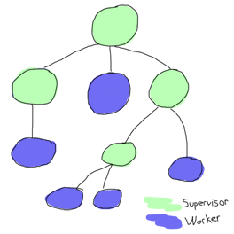
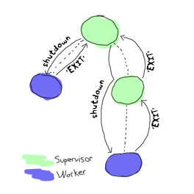
OTP
Enforce patterns via callbacks
-behaviour( .... ).
  application
  gen_event
  gen_sever
  gen_fsm
  supervisor

Slide 26
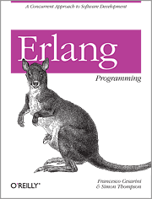


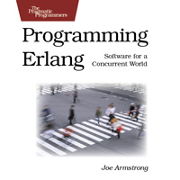

Erlang Community & Resources
Github
erlangcentral.org
erlang.org
erlang-solutions.com
#erlang on Freenode
erlang-questions@erlang.org
Notes:
Declarative/functional: no shared state, no mutation, recursion, no global namespace
Concurrent: "multiple processes executing during the same period of time". Might not be in parallel
Parallel: execution literally occurs at the same instant, for example on separate processors of a multi-processor machine
Soft: the usefulness of a result degrades after its deadline, thereby degrading the system's quality of service.

Slide 27


Erlang Variants
Lisp Flavored Erlang (LFE)
  lfe.io
Elixir
  elixir-lang.org
Notes:
Robert Virding
José Valim

Slide 28



Acknowledgements
Jordan Wilberding - @jlwilberding
Erlware - @erlware
Erlang Solutions
Erlang Central
LearnYouSomeErlang.com – graphics
Dan Grossman (UW) - OOP vs. Functional Decomposition
- office space @ 303 Colorado St.
Questions?

